Slide 1
UML
Diagrams
Notes:
<number>

Slide 2
Diagrams in UML
A Diagram is the graphical presentation of a set of elements, most often rendered as a connected graph of things and relationships. UML includes 9 such diagrams.
1. Class Diagram.
2. Object Diagram.
3. Use Case Diagram.
4. Sequence Diagram.
5. Collaboration Diagram.
6. State Chart Diagram.
7. Activity Diagram.
9. Deployment Diagram.
Notes:
<number>

Slide 3
Diagrams in UML
In UML there are two basic categories of diagrams: structure diagrams and behavior diagrams
The purpose of structure diagrams is to show the static structure of the system being modeled. They include the class, component, and or object diagrams.
Behavioral diagrams, on the other hand, show the dynamic behavior between the objects in the system, including things like their methods, collaborations, and activities. Example behavior diagrams are activity, use case, and sequence diagrams.
Notes:
<number>

Slide 4
Diagram Types
Structural Diagrams
focus on static aspects of the software system
Class, Object, Component, Deployment
Behavioral Diagrams
focus on dynamic aspects of the software system
Use-case, Interaction, State Chart, Activity
<number>
Notes:
<number>

Slide 5
Structural Diagrams
Class Diagram
set of classes and their relationships. Describes interface to the class
Object Diagram
set of objects (class instances) and their relationships
Component Diagram
logical groupings of elements and their relationships
Deployment Diagram
set of computational resources (nodes) that host each component.
<number>
Notes:
<number>

Slide 6
Behavioral Diagrams
Use Case Diagram
high-level behaviors of the system, user goals, external entities: actors
Sequence Diagram
focus on time ordering of messages
Collaboration Diagram
focus on structural organization of objects and messages
State Chart Diagram
event driven state changes of system
Activity Diagram
flow of control between activities
<number>
Notes:
<number>

Slide 7
Design Process
System requirements
legend
Use Case
Model
Class
Diagram
Structural
Behavioral
Activity/Sequence
Diagram
State
Chart
Component
Diagram
Deployment
Diagram
Notes:
<number>

Slide 8
Use case diagrams
Use Case Diagrams
Use Case Diagrams describe the functionality of a system and users of the system. These diagrams contain the following elements:
Actors, which represent users of a system, including human users and other systems.
Use Cases, which represent functionality or services provided by a system to users.
Notes:
<number>

Slide 9
Use Cases
Used to describe the main processes in a system and the interactions between the processes (use cases) and external systems or individuals called actors.
Once the overview is developed it can be expanded to include subprocesses.
The use case description is a generic scenario that is a series of sentences describing each step in the interaction between an actor and a use case.
System
Use Case
Use Case
Actor (People)
Actor (Systems)
Use Case
Notes:
<number>

Slide 10
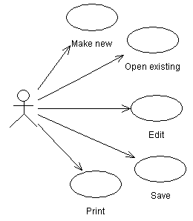
Use case examples (use cases for powerpoint.)
Notes:
<number>

Slide 11
About the last example...
The last example gives a useful view of powerpoint (or any similar application).
The cases are vague, but they focus your attention the key features, and would help in developing a more detailed requirements specification.
It still doesn’t give enough information to characterize powerpoint, which could be specified with tens or hundreds of use cases (though doing so might not be very useful either).
Notes:
<number>

Slide 12
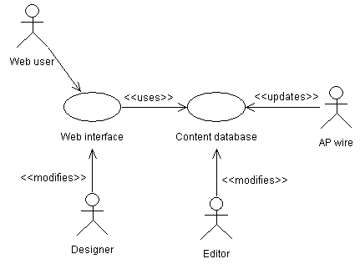
Use case examples (Relationships in a news web site.)
Notes:
<number>

Slide 13
About the last example...
The last is more complicated and realistic use case diagram. It captures several key use cases for the system.
Note the multiple actors. In particular, ‘AP wire’ is an actor, with an important interaction with the system, but is not a person (or even a computer system, necessarily).
The notes between << >> marks are stereotypes: identifiers added to make the diagram more informative. Here they differentiate between different roles (ie, different meanings of an arrow in this diagram).
Notes:
<number>

Slide 14
Class Diagrams
Class Diagrams describe the static structure of a system, or how it is structured rather than how it behaves. These diagrams contain the following elements.
Classes, which represent entities with common characteristics or features. These features include attributes, operations and associations.
Associations, which represent relationships that relate two or more other classes where the relationships have common characteristics or features. These attributes and operations.
Notes:
<number>

Slide 15
UML diagrams: class diagram
Motivated by Object-Oriented design and programming (OOD, OOP).
A class diagram partitions the system into areas of responsibility (classes), and shows “associations” (dependencies) between them.
Attributes (data), operations (methods), constraints, part-of (navigability) and type-of (inheritance) relationships, access, and cardinality (1 to many) may all be noted.
Notes:
<number>

Slide 16
Class diagram “perspective”
Class diagrams can make sense at three distinct levels, or perspectives:
Conceptual: the diagram represents the concepts in the project domain. That is, it is a partitioning of the relevant roles and responsibilities in the domain.
Specification: shows interfaces between components in the software. Interfaces are independent of implementation.
Implementation: shows classes that correspond directly to computer code (often Java or C++ classes). Serves as a blueprint for an actual realization of the software in code.
Notes:
<number>

Slide 17
Example: Class Diagram
Student
Transcript
*
Course
Transcript
studentName
studentID
listOfCourseNames
lilstOfGrades
average
setStudentName()
setStudentID()
addCourseName()
addGrade()
calculateAverage()
show()
Student
studentName
studentID
listOfCoursesID
transcript:Transcript
setStudentName()
getStudentName()
setStudentID()
getStudentID()
addToListofCourseIDs()
makeTranscript()
Course
courseName
courseID
grade
readCourseData()
readCourseGrade()
setCourseID()
Notes:
<number>

Slide 18
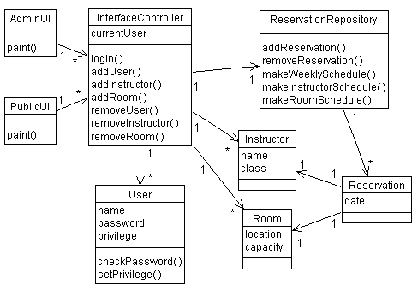
Class diagram examples (A classroom scheduling system: specification perspective.)
Notes:
<number>

Slide 19
About the last example...
Each box is a class, with necessary attributes and operations specified.
Navigability arrows show which classes can reference which others.
Cardinality marked in bi-directional manner on arrows.
The classes together represent the complete system; thus the the classes are a partitioning of the system.
Notes:
<number>

Slide 20
Package diagram
A type of class diagram, package diagrams show dependencies between high-level system component.
A “package” is usually a collection of related classes, and will usually be specified by it’s own class diagram.
The software in two distinct packages is separate; packages only interact through well-defined interfaces, there is no direct sharing of data or code.
Not all packages in a system’s package diagram are new software; many packages (components) in a complex system are often already available as existing or off-the-shelf software.
Notes:
<number>

Slide 21
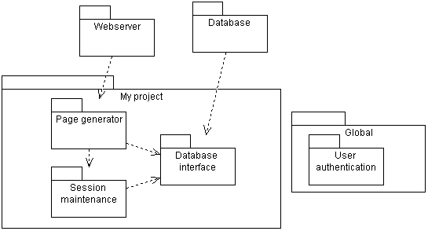
Package diagram example
Notes:
<number>

Slide 22
About the last example...
This package diagram indicates that:
there are three dependent but decoupled software components that will be developed in “My Project”, which is itself a package or component.
Parts of my software depend on some existing software packages, which I won’t be developing, but just using (“Webserver” and “Database”).
There is a globally available package “User authentication” which all the other packages depend on.
Notes:
<number>

Slide 23
Object Diagrams
Object Diagrams describe the static structure of a system at a particular time. Whereas a class model describes all possible situations, an object model describes a particular situation. Object diagrams contain the following elements:
Objects, which represent particular entities. These are instances of classes.
Links, which represent particular relationships between objects. These are instances of associations.
.
Notes:
<number>

Slide 24
Object Diagrams
Objects are also represented in rectangles, their names underlined & written with first letter in small case.
Names of objects can be written in 4 ways:
write only the class name preceded by a colon and underlined : Student
write the name of specific object with it’s class
oneStudent : Student
write only the object name oneStudent:
multiple objects :
: Student
Notes:
<number>

Slide 25
Object Diagrams
newCD:CD
enterDate:Date
scienceL:Lecture
Takes part
languageL:Lecture
:Student
sportsL:Lecture
artL:Lecture
Notes:
<number>

Slide 26
Sequence and Collaboration Diagrams : Interaction Diagrams
An interaction diagram models the dynamic aspects of the system by showing relationships among objects and the messages they may dispatch.
There are two types of interaction diagrams.
Sequence
Collaboration
Sequence Diagram
Collaboration Diagram
Notes:
<number>
Until now, stakeholders have been focusing on the big picture. At this point, designers will shift their focus to individual use cases and how to realize them in the design model. Each of the use-cases to be realized will result in one or more interaction diagrams.
It is not in the scope of this course to identify object collaborations. If you wish to discuss this topic further, refer to the Object-Oriented Analysis with UML course.
If applicable to your class, you can introduce the Rational Unified Process (RUP).
Analysis and Design Workflow
Interaction diagrams are created and refined during the elaboration phase of this workflow for architecturally significant use cases.
For remaining use cases, interaction diagrams are created during the construction phase.

Slide 27
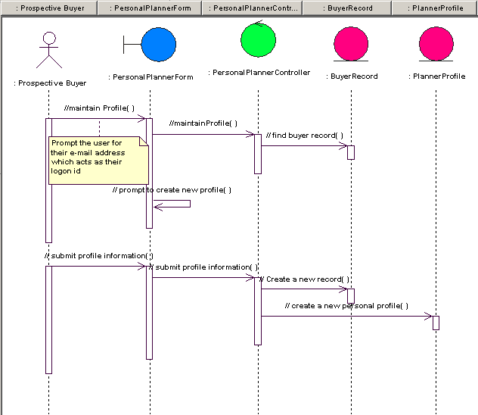
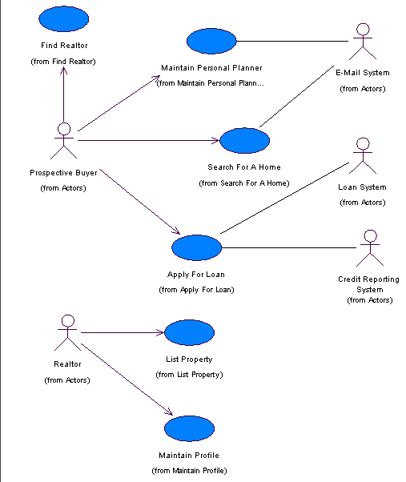
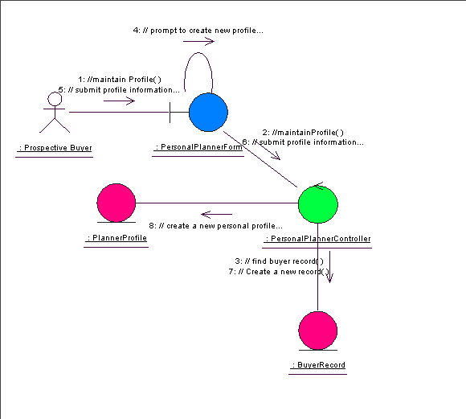
What Are Interaction Diagrams?
As with use-case diagrams, you will use specific input artifacts to create interaction diagrams.
Use-Case Specification
Use-Case Diagram
Glossary
Interaction Diagrams
Notes:
<number>
Interaction diagrams are typically created from numerous sources that may include the following:
Use-case model, including use-case flow of events
Glossary
Software architecture document
Design model
Design guidelines

Slide 28
What Are Interaction Diagrams?
Interaction diagrams are modeled in the Logical View under the appropriate use- case realization.
They are created based on the use cases included in the use-case model and the use-case flow of events.
Notes:
<number>
What is the relationship between a use case’s flow of events and interaction diagrams?
A use case’s flow of events describes a sequence of transactions performed by a system. Whereas, interaction diagrams visually capture a single instance of a use case’s flow of events. Therefore, there can be a collaboration diagram and/or a sequence diagram for each flow through the use case.
For example, a use case may have a main flow (the “Happy Path”) and two alternate flows. You would create at least one interaction diagram for each flow. In this case, there would be a minimum of three diagrams.

Slide 29
Collaboration Diagrams
A collaboration diagram is made up of the following basic elements
Actors
Objects
Links
Messages
Notes:
<number>
We’ve already discussed actors and objects. They play the same roles in the both sequence and collaboration diagrams. Although messages play the same role, we will discuss them again in context to the collaboration diagram.

Slide 30
Actors
An actor is someone or something outside the system that interacts with the system, either by giving or receiving information or both.
Actor
Notes:
<number>
Don’t show the interaction between actors in either sequence or collaboration diagrams because actors are, by definition, outside the system.
Normally an actor instance occurs in the sequence or collaboration diagram as the invoker of the interaction.
If you have several actor instances in the same diagram, try to keep them in the periphery of the diagram.
In sequence diagrams, actors who initiate an action generally appear on the left side. Passive actors appear to the right side of the diagram.

Slide 31
Objects
An object is an entity with a well-defined boundary and identity that encapsulates state and behavior.
An object is an instance of a class.
In UML, the object is represented by a rectangle with the object name underlined.
History 101
History 101 :
: CourseOffering
CourseOffering
Object name
Object name and class name
Class name only
Notes:
<number>
You can represent objects in the following ways. You can have:
An object name only. Normally, you create a sequence or collaboration diagram with objects first and specify their classes later.
An object name and class.
A class name only. However, you should name them if you want to discriminate different objects of the same class.
Note that an object's class can be represented in a sequence or collaboration diagram, if it actively participates in the collaboration.
Depending on your settings in Rose, the object can also be one of the other three stereotype displays (none, icon, or decoration).
Remind students that state is represented by attributes and relationships. Behavior is represented by operations.

Slide 32
Links
A link is a pathway for communication between objects on a collaboration diagram.
In the UML, an object link is represented by a solid line between two objects.
BITS C342
:CourseController
Notes:
<number>
Objects can also have a link to self, meaning that an object is sending the message back to itself.
Remind students about the stereotype displays and that our example uses the icon, since it is the default value.

Slide 33
Messages
A message is the communication between two objects that triggers an event.
In the UML, an object message is represented by a labeled arrow above the link in a collaboration diagram.
BITS C342
1.enroll( )
:CourseController
Notes:
<number>
The arrow points along the link in the direction of the target object (the one that receives the message).
The arrow is labeled with the name of the message and its parameters.
The arrow may also be labeled with a sequence number to show the sequence of the message in the overall interaction.
Sequence numbers are often used in collaboration diagrams because they are the only way to describe the relative sequencing of messages.

Slide 34
Collaboration Diagrams
Collaboration Diagrams describe interactions among classes and associations. These interactions are modeled as exchanges of messages between classes through their associations. Collaboration diagrams are a type of interaction diagram. Collaboration diagrams contain the following elements.
Class roles, which represent roles that objects may play within the interaction.
Association roles, which represent roles that links may play within the interaction.
Message flows, which represent messages sent between objects via links. Links transport or implement the delivery of the message.
Notes:
<number>

Slide 35
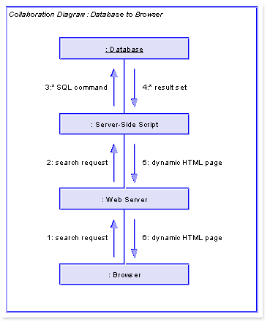
Notes:
<number>

Slide 36
Collaboration Diagrams
Provides a second way of showing the sequence in which events occur
Objects are shown in rectangles connected by lines that indicate links between them.
Numbers indicate the order in which the operation is executed.
The numbers are written together with the message name and an arrow that indicates direction of flow.
Notes:
<number>

Slide 37
Collaboration Diagram
1: Message name
: Class name
: Class name
2: Message name
(parameter list)
object name: Class name
attribute
attribute = value
Notes:
<number>

Slide 38
Example: A Cellular Phone
Consider software that controls basic cellular phone.
Basic things needed:
Buttons, display etc.,
Structurally represented by Class diagrams.
Notes:
<number>

Slide 39
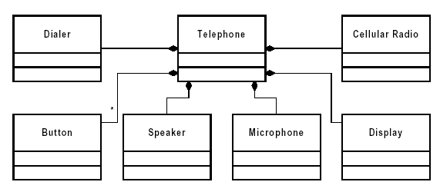
Example: A Cellular Phone
Class diagram represents static model
Notes:
<number>

Slide 40
Example: A Cellular Phone
Is the static model correct?
Is it close to real world?
What about relationships?
How does the cellular phone works?
Notes:
<number>

Slide 41
Example: A Cellular Phone
Use case: Make a Phone call
Cellular Phone
Phone call
User
Make a Phone call
Notes:
<number>

Slide 42
Example: A Cellular Phone
Use case: Make a Phone call
Press digits to enter phone number.
For each digit display is updated.
For each digit, dialer generates the corresponding tone and emits it from the speaker.
Press “Send”.
Display shows “in use”.
Cellular radio establishes a connection to network.
Connection is made.
Notes:
<number>

Slide 43
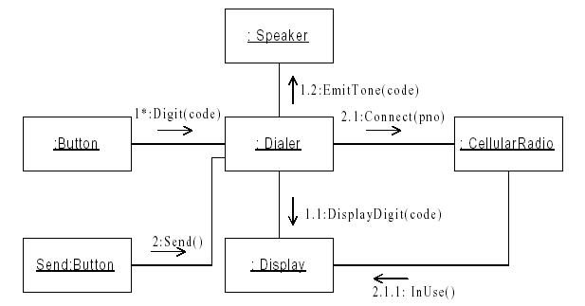
Example: A Cellular Phone
How do the objects in the static model collaborate to execute use case scenario?
Notes:
<number>

Slide 44
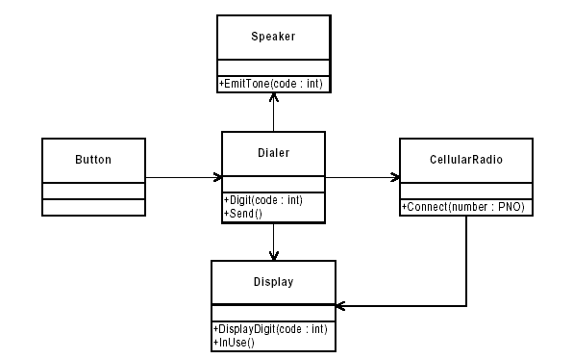
Revisiting Static Model
Is dynamic model is same as static model?
Which is highly coupled?
Notes:
<number>

Slide 45
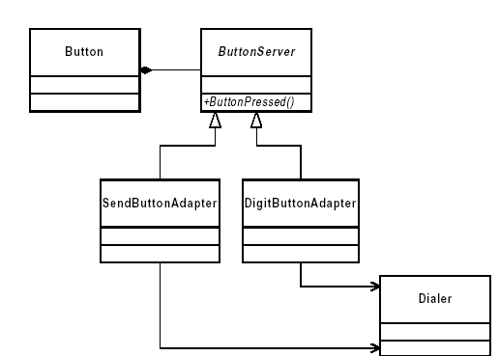
Example: A Cellular Phone
Which button is pressed-send or digit?
Notes:
<number>

Slide 46
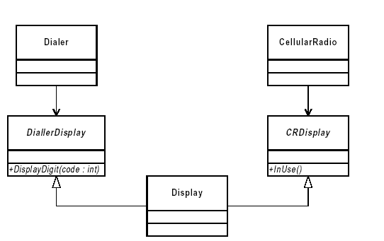
Example: A Cellular Phone
If a “dialler” needs modification in display function?
Notes:
<number>

Slide 47
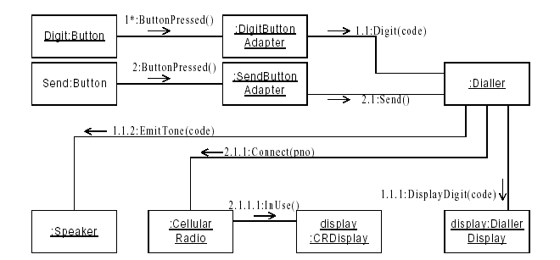
Example: A Cellular Phone
Final Iteration
Notes:
<number>

Slide 48
What Are Sequence Diagrams?
A sequence diagram is an interaction diagram that emphasizes the time ordering of messages.
A sequence diagram is made up of the following basic elements
Actors
Objects
Messages
Lifelines
Focus of control
Notes:
<number>
Like collaboration diagrams, sequence diagrams are the primary source of information used to determine class responsibilities and interfaces.
Sequence diagrams describe a pattern of interaction among objects, arranged in a chronological order.
It shows the objects participating in the interaction by their "lifelines" and the messages that they send to each other.
Sequence diagrams are semantically equivalent to collaboration diagrams. Messages are simply time ordered.
In Rose, you can activate Sequence numbering from the Options window. It is not a default because the location of the arrows show the relative sequence of events.

Slide 49
Lifelines
A lifeline represents the existence of the object at a particular time.
In the UML, an object symbol is drawn at the top of the lifeline.
BITS GC342
Lifeline
Notes:
<number>

Slide 50
Focus of Control
A focus of control shows the period of time during which an object is performing an action, either directly or through a subordinate procedure.
In the UML, focus of control is represented by a tall, thin rectangle.
BITS GC342
Focus of Control
Notes:
<number>
The top of the rectangle is aligned with the start of the action, the bottom of the rectangle with the end of the action.
The focus of control is set up from the Diagram tab in the Options window. It is a default in Rational Rose. If you don’t want the focus of control to display on your sequence diagrams, go to the Options window to turn off the feature.

Slide 51
Messages
A message is the communication between two objects that triggers an event.
In the UML, an object message is represented by a labeled arrow in a sequence diagram.
BITS GC342
:CourseController
Message
enroll( )
Notes:
<number>
The arrow points in the direction of the target object (the one that receives the message).
The arrow is labeled with the name of the message and its parameters.
Objects can also have a message back to itself, meaning that an object is invoking an operation that is defined in its own class’s definition.
The arrow may also be labeled with a sequence number to show the sequence of the message in the overall interaction. For sequence diagrams, numbering is turned off as the default in Rose. The location of the arrow shows the relative sequence of events.

Slide 52

A Cellular Phone
Notes:
<number>

Slide 53
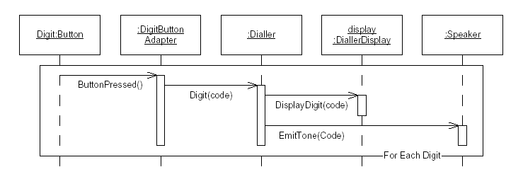
Example: A Cellular Phone
Sequence diagram 1
Notes:
<number>

Slide 54
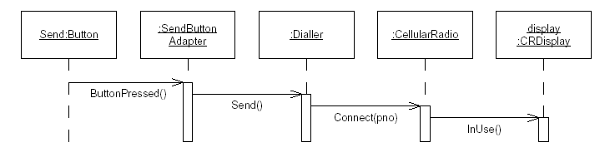
Example: A Cellular Phone
Sequence diagram 2
Notes:
<number>

Slide 55
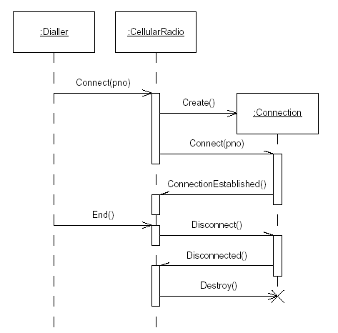
Example: A Cellular Phone
How objects can be created or destroyed?
Notes:
<number>

Slide 56
Sequence Diagrams
Sequence Diagrams describe interactions among classes. These interactions are modeled as exchange of messages. These diagrams focus on classes and the messages they exchange to accomplish some desired behavior. Sequence diagrams are a type of interaction diagrams. Sequence diagrams contain the following elements:
Class roles, which represent roles that objects may play within the interaction.
Lifelines, which represent the existence of an object over a period of time.
Activations, which represent the time during which an object is performing an operation.
Messages, which represent communication between objects.
Notes:
<number>

Slide 57
Sequence diagram
Sequence diagram describe algorithms, though usually at a high level: the operations in a useful sequence diagram specify the “message passing” (method invocation) between objects (classes, roles) in the system.
The notation is based on each object’s life span, with message passing marked in time-order between the objects. Iteration and conditional operations may be specified.
May in principle be used at the same three levels as class diagrams, though the specification level will usually be most useful. (At the implementation level, you might better use pseudocode.)
Notes:
<number>

Slide 58
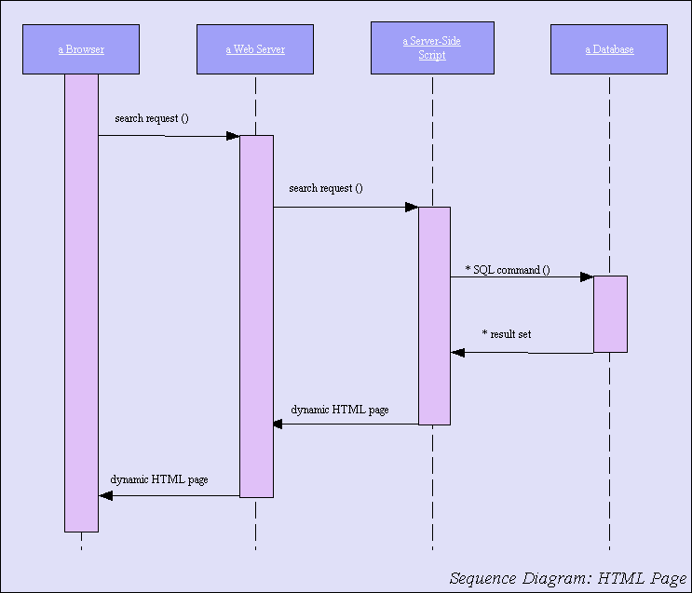
Sequence Diagram
Notes:
<number>

Slide 59
Sequence Diagram
Graphical way to illustrate a scenario
They show the sequence in which objects pass messages to each other
Message : request to an object to perform a method (invoke a method)
They show when objects are created and destroyed
Notes:
<number>

Slide 60
Sequence diagram notation
(This is not an object)
object:
:Class
Class
object:
Event name
Event (number)
3 min.
Notes on what´s happening
Event
{constraints}
Event
Event
Event
Outside the system
Outside the system
Notes:
<number>

Slide 61
Sequence diagram notation
(This isn´t a SW object)
object:
:Class
object:
Event
(message name)
object:
Notes on what´s happening
Event
Event
Event
{constraints}
Event (message name)
Outside the system
Outside the system
X
Notes:
<number>

Slide 62
Example: “MakeTranscript” Sequence Diagram
<<somebody invokes makeTranscript() of object :Student >>
:Student
makeTranscript()
<<create>>
:Transcript
setStudentID( )
<<for each Course in listofCourseID of object Student>>
setStudentName( )
<<create>>
:Course
setCourseID( )
getGrade( )
courseName
readCourseName
addCourseName( )
courseGrade
readCourseGrade
addGrade ( )
<<destroy>>
X
<<Read-methods access a database>>
show ( )
calculateAvg( )
<<destroy>>
X
Notes:
<number>

Slide 63
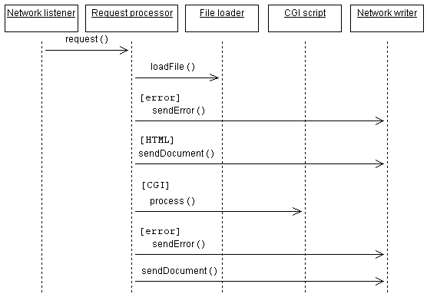
Sequence diagram example
Notes:
<number>

Slide 64
About the last example...
Each box with connected line represents a distinct thing, where all the things aren’t necessarily in the same piece of software, or software at all.
Arrows indicate message passing. That is, an arrow indicates that one thing tells another thing to do something.
Reverse arrows are implied. If arrow goes from A to B, and then immediately afterward an arrow goes from A to something else, it is understood that B completed it’s operation and returned control (and a result, probably) to A.
Time runs down the page. An comes before an arrow that is below it.
Bracketed expressions indicate conditions. In the diagram, an error document is returned if the fileLoad() operation returns and error.
Notes:
<number>

Slide 65
Sequence and Collaboration Diagram: Similarities
Semantically equivalent
Can convert one diagram to the other without losing any information
Model the dynamic aspects of a system
Model a use-case scenario
Notes:
<number>
Because they both derive the same information from the UML’s metamodel; sequence diagrams and communication diagrams are semantically equivalent. As a result, you can take a diagram in one form and convert it to the other without any loss of information.
Show the students the similarities between sequence and communication diagrams.
Go back and point to the semantic similarities between the two diagrams.

Slide 66
Sequence and Collaboration Diagram: Differences
Sequence diagrams | Collaboartion diagrams
Show the explicit sequence of messages Show execution occurrence Better for visualizing overall flow Better for real-time specifications and for complex scenarios | Show relationships in addition to interactions Better for visualizing patterns of communication Better for visualizing all of the effects on a given object Easier to use for brainstorming sessions
Notes:
<number>
Sequence and communication diagrams express similar information, but show it in different ways.
Communication diagrams emphasize the structural communication of a society of objects and show a clearer picture of the pattern of relationships and control that exist among the objects participating in a use case.
Communication diagrams also show more structural information, such as the relationships among objects.
Communication diagrams are better for understanding all the effects of a given object and for procedural design.
Sequence diagrams show the explicit sequence of messages and are better for real-time specifications and complex scenarios.
A sequence diagram includes chronological sequences but does not include object relationships.
Sequence numbers are often omitted in sequence diagrams, in which the physical location of the arrow shows the relative sequence.
On sequence diagrams, the time dimension is easier to read, the operations and parameters are easier to present, and the larger number of objects are easier to manage than in communication diagrams.
Both sequence and communication diagrams allow you to capture semantics of the use-case flow of events. They help identify objects, classes, interactions, and responsibilities, as well as validate the architecture.
Show the students the differences between the two diagrams.
The use of sequence versus communication diagrams is a personal choice. This course does not recommend one over the other, but describes the advantages of each.
For brainstorming, some find the communication diagram easier, a closer visual representation of CRC cards.
The students should use the diagram they like best. However, you may want to recommend that they ultimately create the communication diagram to find relationships between the associated classes.
Note: RUP recommends that communication diagrams be used in analysis and that sequence diagrams be used in design.

